Slide 1
Docker Course
Why we use Docker?
How to create an AWS account?
How to install Docker on VM?
Docker commands.
Build and run an image as a container and then share images using Docker Hub.
Deploy Docker applications using multiple containers with a database.
Learn how to configure the HTTP server?
Type of Network in Docker and how to create it?
Type of Volume and how to to create it?
Docker Swam
How to scan your images for security vulnerabilities.
Why we need Kubernetes?

Slide 2
Agenda
Difference between Management Modules and Command.
How to create Container?
Difference between Create and RUN command.
When we use background and foreground option with Run command.
In the Lab section, we will learn how to create container.
Create, Start and attach the container.
Image pull for different version.
How to list the running and shutdown containers?
How to delete the container?

Slide 3
Command Line
docker
--help

Slide 4
Management Command
Management Commands:
app* Docker App (Docker Inc., v0.9.1-beta3)
builder Manage builds
buildx* Build with BuildKit (Docker Inc., v0.6.1-docker)
config Manage Docker configs
container Manage containers
context Manage contexts
image Manage images
manifest Manage Docker image manifests and manifest lists
network Manage networks
node Manage Swarm nodes
plugin Manage plugins
scan* Docker Scan (Docker Inc., v0.8.0)
secret Manage Docker secrets
service Manage services
stack Manage Docker stacks
swarm Manage Swarm
system Manage Docker
trust Manage trust on Docker images
volume Manage volumes
Docker
Command
Commands:
attach Attach local standard input, output, and error streams to a running container
build Build an image from a Dockerfile
commit Create a new image from a container's changes
cp Copy files/folders between a container and the local filesystem
create Create a new container
diff Inspect changes to files or directories on a container's filesystem
events Get real time events from the server
exec Run a command in a running container
export Export a container's filesystem as a tar archive
history Show the history of an image
images List images
import Import the contents from a tarball to create a filesystem image
info Display system-wide information
inspect Return low-level information on Docker objects
kill Kill one or more running containers
load Load an image from a tar archive or STDIN
login Log in to a Docker registry
logout Log out from a Docker registry
logs Fetch the logs of a container

Slide 5
Management Command
Management Commands:
app* Docker App (Docker Inc., v0.9.1-beta3)
builder Manage builds
buildx* Build with BuildKit (Docker Inc., v0.6.1-docker)
config Manage Docker configs
container Manage containers
context Manage contexts
image Manage images
manifest Manage Docker image manifests and manifest lists
network Manage networks
node Manage Swarm nodes
plugin Manage plugins
scan* Docker Scan (Docker Inc., v0.8.0)
secret Manage Docker secrets
service Manage services
stack Manage Docker stacks
swarm Manage Swarm
system Manage Docker
trust Manage trust on Docker images
volume Manage volumes
Docker

Slide 6
Management Command
Management Commands:
app* Docker App (Docker Inc., v0.9.1-beta3)
builder Manage builds
buildx* Build with BuildKit (Docker Inc., v0.6.1-docker)
config Manage Docker configs
container Manage containers
context Manage contexts
image Manage images
manifest Manage Docker image manifests and manifest lists
network Manage networks
node Manage Swarm nodes
plugin Manage plugins
scan* Docker Scan (Docker Inc., v0.8.0)
secret Manage Docker secrets
service Manage services
stack Manage Docker stacks
swarm Manage Swarm
system Manage Docker
trust Manage trust on Docker images
volume Manage volumes
Docker

Slide 7
Command Line
[root@ ~]# docker container --help
Usage: docker container COMMAND
Manage containers
Commands:
attach Attach local standard input, output, and error streams to a running container
commit Create a new image from a container's changes
cp Copy files/folders between a container and the local filesystem
create Create a new container
diff Inspect changes to files or directories on a container's filesystem
exec Run a command in a running container
export Export a container's filesystem as a tar archive
inspect Display detailed information on one or more containers
kill Kill one or more running containers
logs Fetch the logs of a container
ls List containers
pause Pause all processes within one or more containers
port List port mappings or a specific mapping for the container
prune Remove all stopped containers
rename Rename a container
restart Restart one or more containers
rm Remove one or more containers
run Run a command in a new container.
docker
container
--help

Slide 8
Command Line
[root@ ~]# docker container --help
Usage: docker container COMMAND
Manage containers
Commands:
attach Attach local standard input, output, and error streams to a running container
commit Create a new image from a container's changes
cp Copy files/folders between a container and the local filesystem
create Create a new container
diff Inspect changes to files or directories on a container's filesystem
exec Run a command in a running container
export Export a container's filesystem as a tar archive
inspect Display detailed information on one or more containers
kill Kill one or more running containers
logs Fetch the logs of a container
ls List containers
pause Pause all processes within one or more containers
port List port mappings or a specific mapping for the container
prune Remove all stopped containers
rename Rename a container
restart Restart one or more containers
rm Remove one or more containers
run Run a command in a new container.

Slide 9
Create a new Container
https://docs.docker.com/engine/reference/commandline/create/
docker container create
Create the Container and Start it?
docker container run
Create the Container, Start and then execute some command?
docker container run
Create
Create a new container. (Only Create)
run
Run a command in a new container. (Create + Start)
Create the container only?
It means it will create container and then do nothing.
Start and shutdown the container.
Notes:
Many people confuse about the use of create and run option and even in interview interviewer ask these simple questions.
run option carrying more power, this is the reason, people uses only run option instead of create.

Slide 10
What options, we can use with run
docker container run [OPTIONS] IMAGE[:TAG|@DIGEST] [COMMAND] [ARG...]
Let’s explore more [OPTIONS]
When starting a Docker container, we should know that to run the container in the background in a “detached” mode or in the default foreground mode.
To start a container in detached mode, you use -d=true or just -d option.
When we execute the command "docker container run -d (detached) waits for the process being run to exit.
In simple words, we can say that with “–d” option, it first start container, then execute the command and after that shutdown/or keep running the container.
Further, If you use -d with --rm, the container is removed when it exits. "--rm" option will delete the newly created container. This option is useful when we do the testing if our container is working as expected.
We will cover in our upcoming slides.
background
docker
container
run
foreground
Notes:
Container create and Start == docker container run

Slide 11
In Linux, whenever, we execute a script we take the input for variable from terminal that we called STDIN or
When this script produce output, we called this STDOUT
and script gives some error we called at STDERR.
Foreground
In this mode, docker run can start the process in the container and attach the console to the process’s standard input, output, and standard error.
All of that is configurable:
-a=[] : Attach to `STDIN`, `STDOUT` and/or `STDERR`
-t : Allocate a pseudo-tty (Terminal)
--sig-proxy=true: Proxy all received signals to the process (non-TTY mode only)
-i : Keep STDIN open even if not attached
If you do not specify -a then Docker will attach to both stdout and stderr . You can specify to which of the three standard streams (STDIN, STDOUT, STDERR) you’d like to connect instead, as in:
docker run -a stdin -a stdout -i -t ubuntu /bin/bash
For interactive processes (like a shell), you must use -i -t together in order to allocate a tty for the container process. -i -t is often written -it as you’ll see in later examples.
Notes:
For next slide, Whenever, we create container, we need an Image. This image we pull from the Docker hub repository. We will definitely cover this topic.

Slide 12
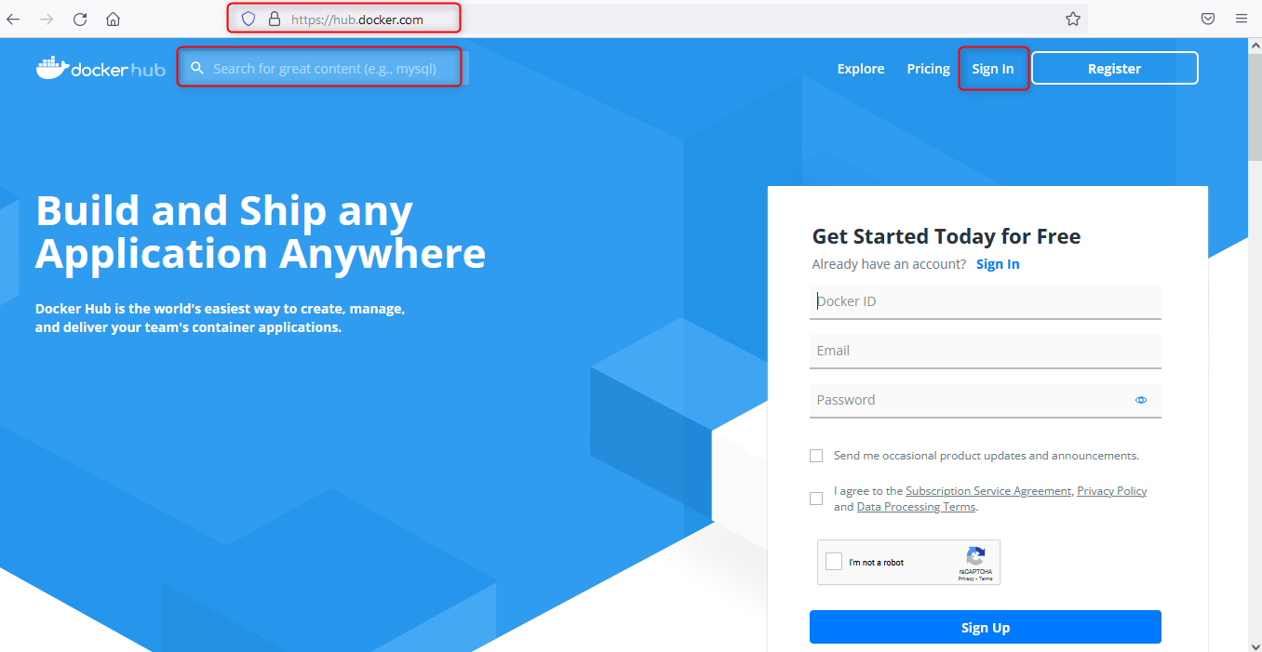

Slide 13
Let’s do the Lab

Slide 14
How to stop and Start the Container?
start Start one or more stopped containers
stop Stop one or more running containers
pause Pause all processes within one or more containers
unpause Unpause all processes within one or more containers

Slide 15
Difference between Pause and Stop option
https://docs.docker.com/engine/reference/commandline/pause/
The docker pause command suspends all processes in the specified containers.
On Linux, this uses the freezer cgroup.
SIGSTOP = SIG (Signal) STOP => STOP Signal. Its behaviour is to pause that process. So, When this signal send to process, it pause that process in its current state. And resume execution if it is sent the SIGCONT signal.
Container would be in remain in memory portion till it is in pause state.
It will use the memory portion again if we unpause this container.
Use case would be: pause the resource which do intensive tasks that can be resumed after some time.
Pause option could be used in future for live migration of container from one host to another.
https://docs.docker.com/engine/reference/commandline/stop/#options
The main process inside the container will receive SIGTERM, and after a grace period, SIGKILL.
--time,-t 20 Seconds to wait for stop before killing it
SIGTERM: SIG (SIGNAL) TERM (Termination) : Its behavior is to terminate the process. The SIGTERM gracefully kills the process whereas SIGKILL kills the process immediately.
However, with Stop option, it releases the memory used, once container is stopped.
Use case would be to stop the container if no use. ☺

Slide 17
How to stop and Start the Container?
start Start one or more stopped containers
stop Stop one or more running containers
pause Pause all processes within one or more containers
unpause Unpause all processes within one or more containers
docker container start containerID/container-name
docker container stop containerID/container-name
docker container pause containerID/container-name
docker container unpause containerID/container-name

